Slide 1
Last time…
Comparison of floating point values.
Pointer arithmetic.
Array traversal using pointer arithmetic.
More character arrays and void pointers.
Stack Implementation in C++.

Slide 2
Dynamic Memory Allocation
Mohammad Salman
Dean’s Fellow

Slide 3
Eventually, we’ll start seeing some relaxations to some of these restrictions when we learn about dynamic arrays and inheritance (OOP).
Accompanying note in the notes section of this slide.
Some characteristics of a Python List
List can contain multiple data types.
List may have user-defined length.
List size/length is modifiable once the list has been created.
Arrays can contain only a single data type.
Size/length of arrays must be known at compile time.
Size/length of an array isn’t modifiable once it has been created.
Notes:
This slide+notes copied over from the Week 2 Lecture on Arrays.
Animations enabled.
Note (for the third point): In Python, lists are based on arrays. When you resize a list, you see the list’s length being changed on the surface. On the backend, however, the length of the array (on which the list is based on) is still the same. When that arrays gets fully filled, and you want to add a new element, a new larger array has to be created, and the older array is discarded, in order to accommodate for more variables.

Slide 4
Various Types of Memory Allocation
In order to work with data, we allocate some memory for it.
Three types of allocation.
Static
Automatic
Dynamic
Automatic memory allocation – we’ve been doing this.

Slide 5
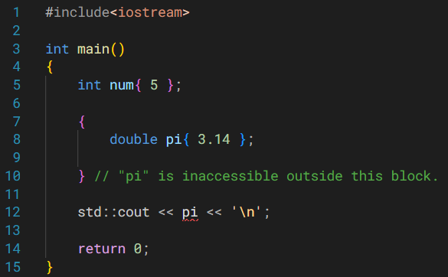
Automatic Memory Allocation
Happens for function parameters and local variables.
Memory is allocated when the relevant block is entered.
Memory is freed when the block is exited.
Allocation/deallocation happens automatically.
Notes:
Memory for num allocated automatically when you initialized it.
Memory for pi allocated automatically when you initialized it.
As soon as the code block ends, pi goes out of scope. In other words, memory for pi has been automatically deallocated.
Same holds true for num; at the end of main(), memory for num is automatically deallocated.

Slide 6
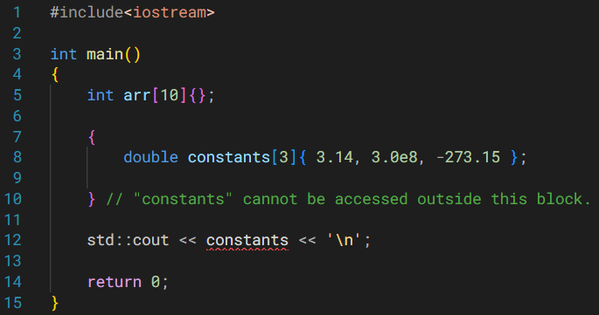
Automatic Memory Allocation
While creating arrays through this style, length must be provided at compile time.
Memory is also handled automatically (same as before).

Slide 7
Problems with Automatic Memory Allocation
Because the length has to be known at compile time…
You would either make very large arrays – wasted/unused memory.
On the flip side, you may end up needing more memory – going out of bounds.
Stack memory is limited, so very large arrays cannot be created (covered under Stack Memory).

Slide 8
Dynamic Memory Allocation

Slide 9
Dynamic Memory Allocation
If we don’t know the length of the array at compile time, use dynamic memory allocation.
Dynamic implies something that happens at runtime.
Essentially, we’re allocating memory at runtime.
Let’s start with dynamically allocating variables.

Slide 10
Dynamic Memory Allocation
double* ptr{ new double{ 17 } };
double* ptr
double
Reserved by the OS for your use.
0x10
17
0x40
0x10
This pointer is the only way to access this reserved memory.

Slide 11
Dynamic Memory Allocation
double* ptr{ new double{ 17 } };
Note the new keyword.
Note that a pointer is returned.
Its value is the address of the memory that the OS has reserved for you.
Dynamically allocated memory can only be accessed through these pointers.

Slide 12
Dynamic Memory Allocation
double* ptr{ new double };
Note that you can allocate memory, without initialization as well.

Slide 13
Dynamic Memory Allocation
There is a catch though…
You’re responsible for deallocating/freeing this memory!
double* ptr{ new double{ 17 } }; // allocation
delete ptr; // deallocation
Notes:
This is unlike automatic and static memory allocation.

Slide 14
Dynamic Memory Allocation
We already saw this…
double* ptr{ new double{ 17 } };
double* ptr
double
Reserved by the OS for your use.
0x10
17
0x40
0x10
This pointer is the only way to access this reserved memory.

Slide 15
Dynamic Memory Allocation
Note You’re using the same pointer for deallocation.
delete ptr; // deallocation
delete ptr is essentially delete 0x10
OS is now free to use this memory for other applications (or maybe your own application later on).
double* ptr
???
0x10
???
0x40
0x10

Slide 16
Dynamic Memory Allocation
Note You’re using the same pointer for deallocation.
delete ptr; // deallocation
delete ptr is essentially delete 0x10
OS is now free to use this memory for other applications (or maybe your own application later on).
double* ptr
???
ptr is left dangling.
0x10
???
0x40
0x10

Slide 17
Dynamic Memory Allocation
delete ptr; // deallocation
ptr = nullptr; // set to nullptr
Set the pointer to nullptr once you’ve freed the memory that it was pointing at.

Slide 18
What does it mean to delete ptr; ?
Some common misunderstandings…

Slide 19
What does it mean to delete ptr; ?
The memory that ptr is pointing to is returned back to the operating system.
The OS is then free to reassign that memory to another application (or to this application again later).
The delete operator does not actually delete or remove anything.
The number of available memory locations does not shrink.
In fact, the pool of free memory has increased because of deallocation.

Slide 20
What does it mean to delete ptr; ?
Also, we are not deleting the pointer variable, ptr.
You can still work with ptr as long as it’s in scope.
Once you have performed delete, you can have ptr point to some other entity.
ptr = &another_entity;
You also saw that it could be set to nullptr.
ptr = nullptr;
You can dynamically allocate memory again.
ptr = new int{-13};

Slide 21
An Implication of delete

Slide 22
An Implication of delete
Couple of questions…
What if you had two (or more) pointers pointing at the same memory address, and that address gets deallocated?
Similarly, what if you had two (or more) pointers pointing at the same variable, and that variable goes out of scope?

Slide 23
double* ptr{ new double{ 17 } };
double* ptr2{ ptr };
double* ptr
double
0x10
17
0x40
0x10
double* ptr2
0x10
0x80

Slide 24
double* ptr{ new double{ 17 } };
double* ptr2{ ptr };
// ptr is left dangling
delete ptr; // delete 0x10
What about ptr2 though?
double* ptr
???
0x10
???
0x40
0x10
double* ptr2
0x10
0x80

Slide 25
double* ptr{ new double{ 17 } };
double* ptr2{ ptr };
// ptr is left dangling
delete ptr; // delete 0x10
What about ptr2 though?
Also left in a dangling state.
double* ptr
???
0x10
???
0x40
0x10
double* ptr2
0x10
0x80

Slide 26
double* ptr{ new double{ 17 } };
double* ptr2{ ptr };
// ptr is left dangling
delete ptr; // delete 0x10
ptr = nullptr;
ptr2 = nullptr;
Set both to nullptr.
double* ptr
???
0x0
???
0x40
0x10
double* ptr2
0x0
0x80

Slide 27
Recommendations to Avoid this Issue
Try to avoid having multiple pointers pointing at the same memory location.
Set dangling pointers to nullptr.

Slide 28
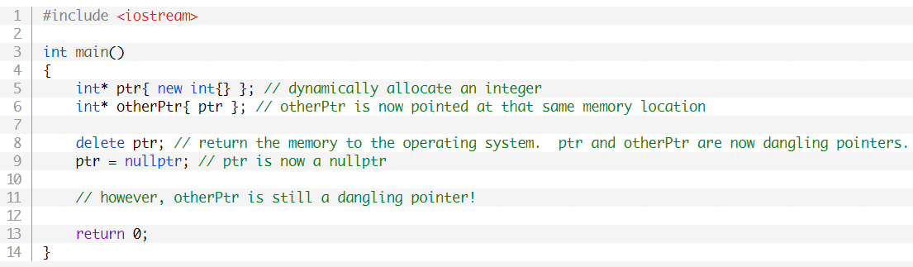
An Implication of delete
Self-study Go through the program.

Slide 29
Dynamically Allocating Arrays
Choosing lengths at runtime…

Slide 30
Dynamically Allocating Arrays
new[]
delete[]
Lengths of dynamically allocated arrays can be chosen at runtime.
This is unlike fixed arrays.
int* arr{ new int[len]{} };
delete[] arr;
arr = nullptr;
int len{};
std::cin >> len;
Notes:
All elements of the dynamic array initialized to zero.

Slide 31
Dynamically Allocating Arrays
new[]
delete[]
The pointer is pointing at the first element of the dynamic array.
With dynamically allocated arrays, you again need to keep track of the length using a separate variable.
sizeof() will just give you the size of the pointer.
Dynamically allocated arrays can have much larger lengths than fixed arrays.
This is because heap memory is much larger than stack memory (later in the lecture).
Notes:
All elements of the dynamic array initialized to zero.

Slide 32
Dynamically Allocating Arrays
new[]
delete[]
A natural question comes up.
How does delete[] know how much memory to deallocate?
We don’t pass the size of the dynamic array to it.
new[] keeps track of how much memory was reserved, so that delete[] can deallocate the proper amount.
This information, however, is hidden away from us.
Notes:
All elements of the dynamic array initialized to zero.

Slide 33
Stack vs. Heap

Slide 34
Stack vs. Heap
There are two types of memory that we should know about.
Stack
Heap
Stack is used when you rely on automatic memory allocation.
Heap is used when you rely on dynamic memory allocation.
Each type of memory has its own pros and cons.

Slide 35
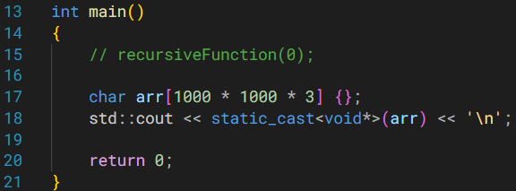
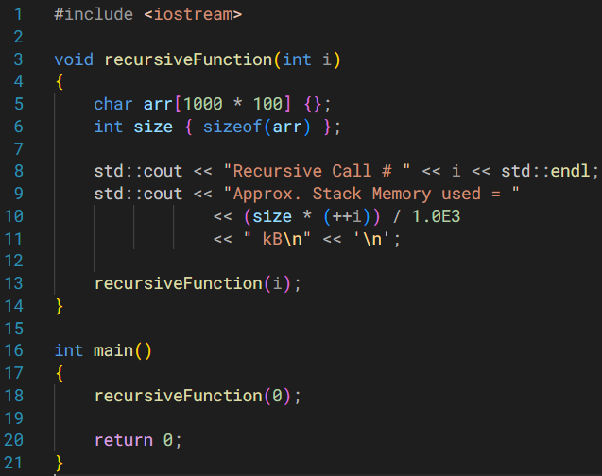
Stack Automatic Memory Alloc.
Accessing stack memory is fast and efficient.
Stack is limited in memory.
Generally, it’s 1 to 2 MB.
If you try exceeding the limit → program crash.
Two examples to accomplish this.
Mess around with the array lengths.
Lengths have to be specified at compile time for arrays on stack.

Slide 36
Heap Dynamic Memory Alloc.
Accessing heap memory is slower compared to stack.
Memory is accessed through a pointer.
Pointer takes you to the memory, and then you dereference it (two steps).
Heaps, generally, have a lot of memory.
Can be gigabytes in size.

Slide 37
Heap Dynamic Memory Alloc.
May happen that you don’t have enough memory in the heap.
If memory allocation fails, your program will crash.
You can allocate memory with this modification.
int* arr{ new (std::nothrow) int[len]{} };
Returns a null pointer if memory allocation fails.
arr ← nullptr
while(arr == nullptr), keep taking input from the user.

Slide 38
Memory Leaks

Slide 39
Memory Leaks
Dynamically allocated memory is not automatically deallocated.
Note that this memory will stay reserved for you until,
You explicitly deallocate it.
Your program or application ends (your OS will reclaim that memory).
But what if you forget to deallocate the dynamic memory, and your program is still running?
Basically you forgot to delete ptr.

Slide 40
void createArray(int length)
{
int* ptr{ new int[length]{} };
}
ptr goes out of scope at the end of this function call.
Recall
The dynamically allocated memory will stay reserved for you until,
You explicitly deallocate it.
Your program ends.
int main()
{
int len{};
std::cin >> len;
createArray(len);
// More code...
return 0;
}
Is ptr a dangling pointer?
NO!
Notes:
There is a difference between dangling pointer and memory leak.

Slide 41
void createArray(int length)
{
int* ptr{ new int[length]{} };
}
ptr goes out of scope at the end of this function call.
When you return back to main(), you cannot access the memory that you just reserved.
You’ve LOST the address.
Also can’t explicitly deallocate it now.
The OS would also not use it for any other purpose.
Available free memory has been reduced – MEMORY HAS BEEN LEAKED.
int main()
{
int len{};
std::cin >> len;
createArray(len);
// More code...
return 0;
}

Slide 42
Memory Leaks
int* ptr{ new int[length]{} };
Understand that ptr is in the stack memory.
So before ptr goes out of scope, make sure that,
Explicitly deallocate the memory using delete ptr or,
Hold on to that address.
Copy/return ptr’s value to another pointer that would still be in scope.

Slide 43

More Memory Leaks
Self-study Why are these leaks? How to resolve them?
Notes:
https://www.learncpp.com/cpp-tutorial/dynamic-memory-allocation-with-new-and-delete/

Slide 44
This is what a memory leak could look like…
https://www.youtube.com/watch?v=iEn0ozP-jxc
7:08 minute mark.

Slide 45
Motivation for Learning Pointers
Understanding how arrays work.
Allowing us to use dynamically allocated memory from the heap.
<LOCKED>
etc…
Notes:
Implementation of various data structures (linked lists, trees)…

